Slide 1
Principal Component Analysis
Data 100
Slides by John DeNero

Slide 2
Announcements

Slide 3
Principal Component Analysis

Slide 4
Principal Component Analysis for Exploratory Data Analysis
Goal: Plot the observations in a high-dimensional data matrix (many attributes) in two dimensions by picking two linear combinations of attributes.
Related Goal: Determine whether this two-dimensional plot is really showing the variability in the data. (If not, be wary of conclusions drawn using PCA.)
PCA is appropriate when:
Visually identifying clusters of similar observations in high dimensions.
You are still exploring the data. (If you already know what to predict, you probably don’t need PCA.)
You have reason to believe that the data are inherently low rank: there are many attributes, but only a few (perhaps unobserved) attributes mostly determine the rest through a linear association.

Slide 5
Principal Component Analysis Computation

Slide 6
Principal Component Analysis: A Procedural View
(Demo)
Step 0: Center the data matrix by subtracting the mean of each attribute column.
Step 1: Find a linear combination of attributes, represented by a unit vector v, that summarizes each row of the data matrix as a scalar.
v gives a one-dimensional projection of the data, the first principal component.
Unit vector v is chosen to minimizes the sum of squared distances between each point and its projection onto v.
Steps 2+: To find n principal components, choose the vector for each one in the same manner as the first, but ensure each one is orthogonal to all previous ones.
Connection to SVD: In practice, you don’t carry out this procedure, but instead use singular value decomposition to find all principal components efficiently.

Slide 7
SVD & PCA
Singular value decomposition (SVD) describes a matrix decomposition:
X = UΣV^{T} (or XV = UΣ) where U and V are orthonormal and Σ is diagonal.
If X has rank r, then there will be r non-zero values on the diagonal of Σ.
The values in Σ, called singular values, are ordered from greatest to least.
The columns of U are the left singular vectors.
The columns of V are the right singular vectors.
Principal component analysis (PCA) is a specific application of SVD:
X is a data matrix centered at the mean of each column and scaled down.
The largest n singular values are kept, for some choice of n; All other singular values are set to zero: the dimensionality reduction.
The first n columns of V are directions for the n principal components.
The first n column of XV or UΣ contain the n principal components of X.

Slide 8

PCA for Two-Dimensional Visualization
(Demo)
Computational recipe for creating a scatter plot using PCA:
For data matrix D with column means D, compute
Use SVD to find XV = UΣ; plot the first two columns of XV (or UΣ).

Slide 9
Variance

Slide 10
Maximizing Variance
Variance is the expected squared deviation from the mean. For a finite set of attribute values with mean of zero, the variance is the average squared value.
odds = np.array([-1, 3, 5, -7]) # Attribute values with zero mean np.var(odds) == np.average(odds**2) == 1/len(odds) * odds @ odds
The total variance of a data matrix is the sum of the variances of the attributes.
The sum of squared singular values in PCA is equal to the total variance of the original data matrix.
Each squared singular value (a component score) indicates how much of the total variance is accounted for by the corresponding principal component.
Dividing by one over square root n is necessary to maintain this relationship.

Slide 11
Scree Plots
(Demo)
A scree plot shows the size of the diagonal values of Σ², largest first.
If the first two singular values are large and all others are small, then two dimensions are enough to describe most of what distinguishes one observation from another. If not, then a PCA scatter plot is omitting lots of information.

Slide 12
Principal Component Analysis: A Declarative View
Step 0: Center the data matrix by subtracting the mean of each column.
Step 1: Find an n dimensional projection of the centered matrix that retains as much of the total variance of the original matrix as possible.

Slide 13
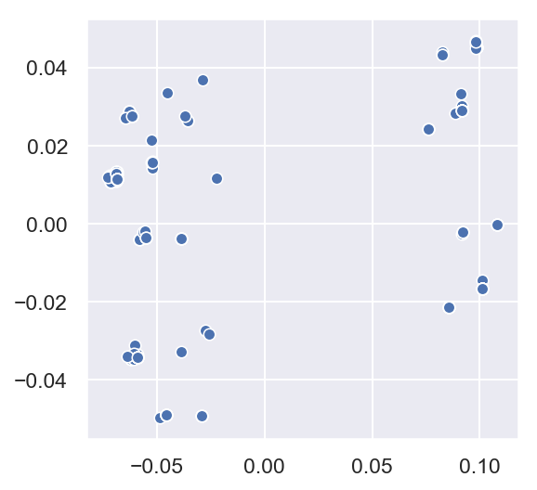
Question: First Principal Component
What’s the relationship between the first singular value and the scale of the x-axis in a PCA scatter plot?
Answer:
The x-axis positions are all the values of of the first column of UΣ. Since U is orthonormal, the column’s length is Σ.
The sum of the squares of these values is the first singular value squared.
Why is this point at (0.11, 0)
What does 0.05 measure?

Slide 14
Interpretation

Slide 15
Inspecting Principal Component Directions (Axes)
(Demo)
A principal component direction is a linear combination of attributes.
Plotting the values of the first principal component direction can provide insight into how attributes are being combined.
High variance attributes are typically included (but not always).
Many attributes are often included, even if only a few are really important.
Interpreting other principal components is challenging; the constraint that they are orthogonal to prior components strongly influences their directions.

Slide 16
Analyzing Attributes Instead of Observations
(Demo)
In some datasets, observations and attributes can be reversed.
How? Transpose the matrix and perform PCA.
SVD on a different matrix: center each row and scale by the square root of the number of columns.
However, the rank of a matrix is the same as the rank of its transpose.

